Slide 1

Introduction to Ecosystems
Year 7 Science
Mr. Yates

Slide 2



Do not delete this slide. It is hidden from your show. You can use it to copy and paste the relevant prompt boxes into your presentation. Click once on the white space to select it for copying. Once it is in your presentation you can double click on the white space to add text. The box will automatically resize to fit your text. The next slide is also hidden and included as an example only.
Check for Understanding
Teacher Cue
Make the Connection
Vocabulary
Extension
Hints

Slide 3
Year 7 – Science Investigations
The boiling points of liquids can be used to separate mixtures
ACSSU113
ACSHE121
ACSIS124
ACSIS125
ACSIS131
ACSIS133

Slide 5
What is sound?
Notes:
Sound is a longitudinal wave of vibrating particles (back and forth)

Slide 6
What is sound?
CFU

Slide 7
Question
Hint

Slide 8
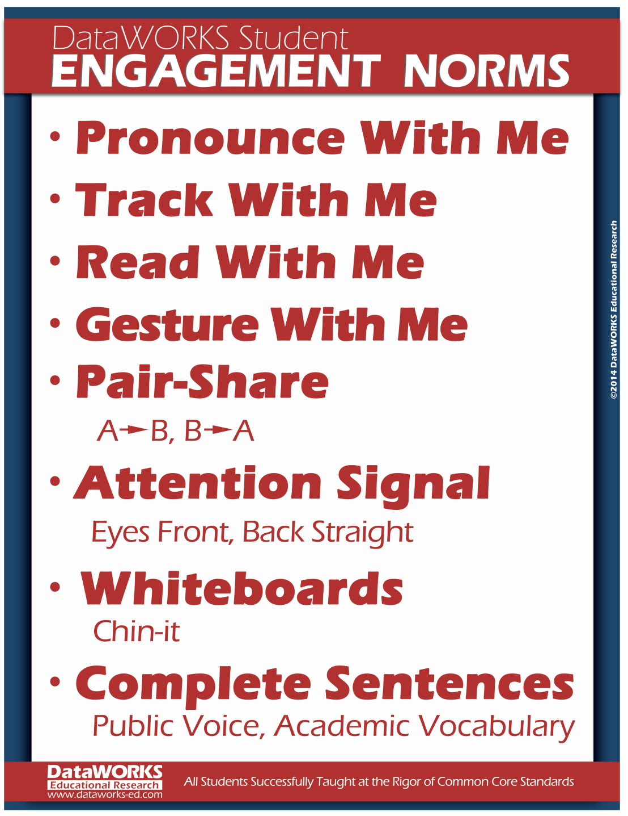
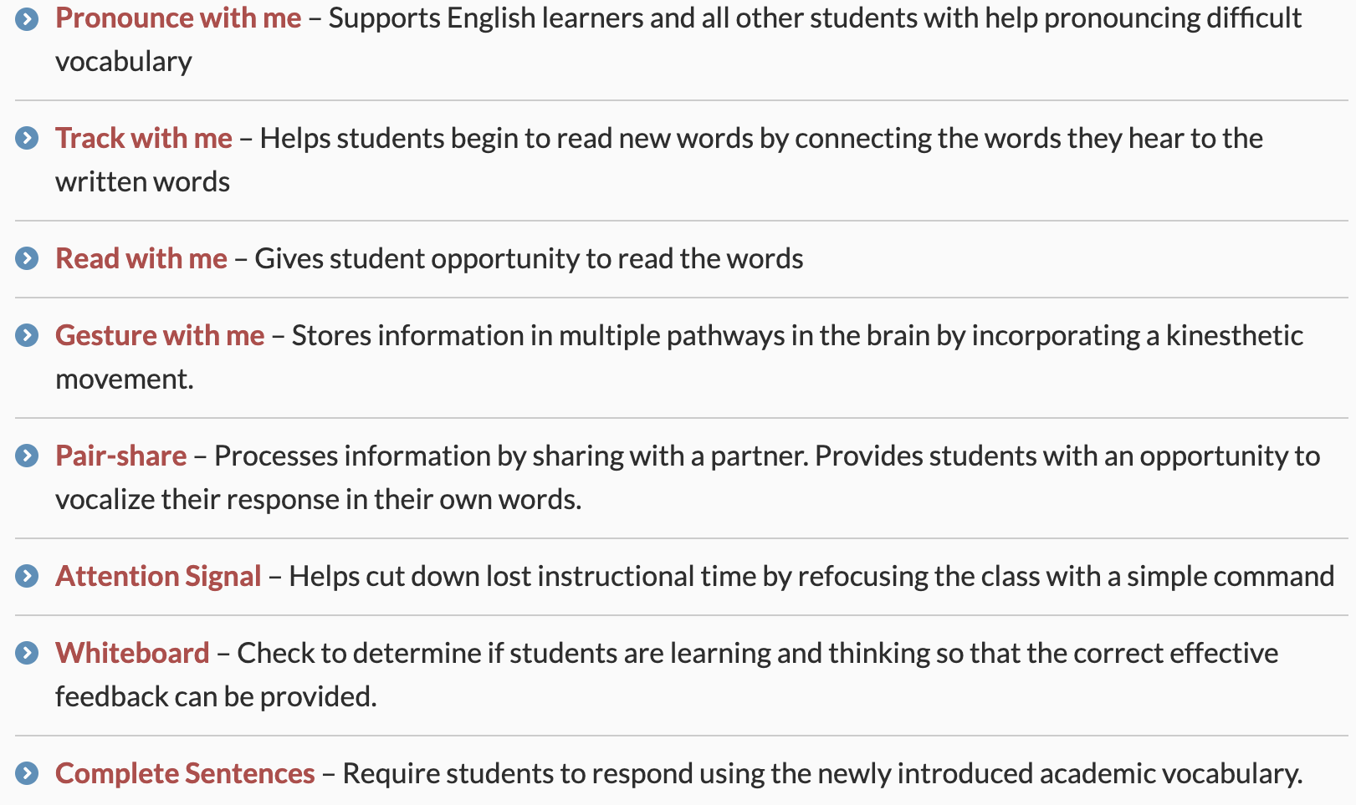

Slide 10
Today we are learning about:
The interactions of living things in ecosystems.
Understand the interrelationship between the biosphere, ecosystems, environment's and habitats.
Understand and identify the different trophic levels that exist in the food pyramid.
State the role of an ecologist.

Slide 11
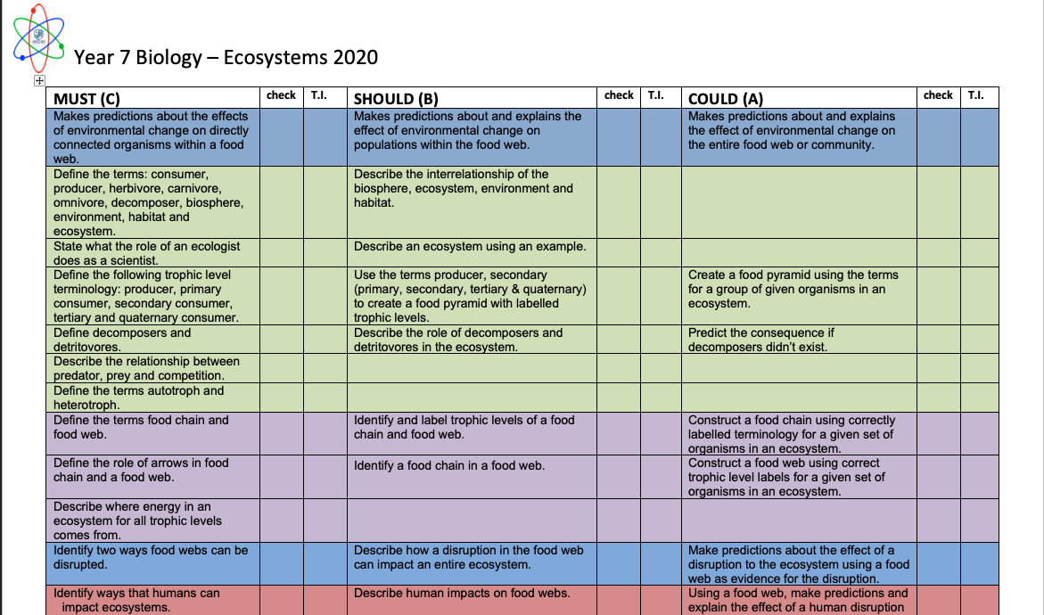

Slide 12
Hints
Think about:
- Think about the conditions (environmental) the animal needs to live.
- Think about its food sources
- Does it have any enemies?
What do you already know about ecosystems?
With your partner pick one animal from below and describe where it lives and what it eats.
Notes:
CFU - call on non-volunteers, then open the floor to volunteers
Make the Connection – we deal with mixtures in the form of everyday things around us all the time.

Slide 13
New Word
An ecosystem is a short name for an ‘ecological system’
Ecosystem
‘Eco’
‘system’
Eco is a spin-off from the word ecology and describes anything having to do with the environment and our relation to it.
system comes from the Greek word systema or "organized body, whole”.
Noun: A system formed by organisms interacting with each other and their non-living surroundings in a balanced way.
Plural: Ecosystems (meaning more than one)

Slide 14
Ecosystems
An ecosystem includes all living things in a specific area and their interactions with the environment around them.
Each living thing in an ecosystem is linked to others, meaning all living things depend on each other for survival.
An ecosystem includes all the biotic (living) and abiotic (non-living) environmental factors of an area and how they interact with one another.
Vocabulary
Ecosystem: A system formed by organisms interacting with each other and their non-living surroundings in a balanced way.
Biotic: Living
Abiotic: Non-Living
Checking for Understanding
An ecosystem includes?
Each living thing in an ecosystem is linked to others, meaning?
An ecosystem includes?
Notes:
Teacher Cue – refer to the vocabulary box as you read through and “unpack” the definition provided. Use hand gestures to emphasise the ”2 or more”, “mixed” and “separated” parts of the definition.
Have students complete CFU 1 as a pair-share, then record these definitions & examples as notes (with diagrams) if desired.
CFU 2 – pair-share, then whiteboards for answers – call on non-volunteers.

Slide 15
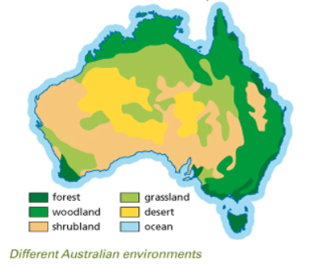
Checking for Understanding
What is an environment?
What does biotic mean?
What does abiotic mean?
Examples of biotic things?
Examples of abiotic things?
Environment
The biotic (living) and abiotic (non-living) things surrounding an organism.
Biotic – living things an organism needs to survive; mates, food, organisms they compete with
Abiotic – non-living things in the environment; temperature, moisture, soil, light
Vocabulary
Ecosystem: A system formed by organisms interacting with each other and their non-living surroundings in a balanced way.
Biotic: Living
Abiotic: Non-Living
Checking for Understanding
What types of biotic/abiotic factors exist in different Australian environments?

Slide 16
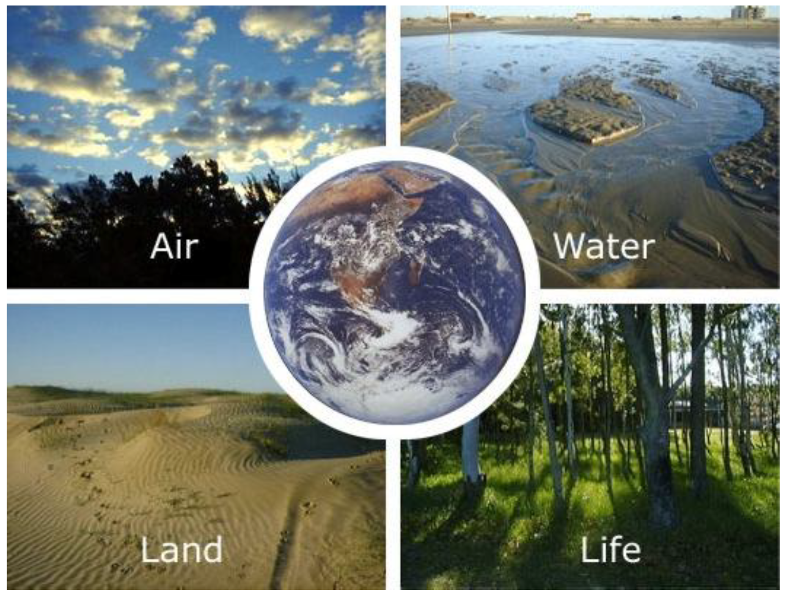
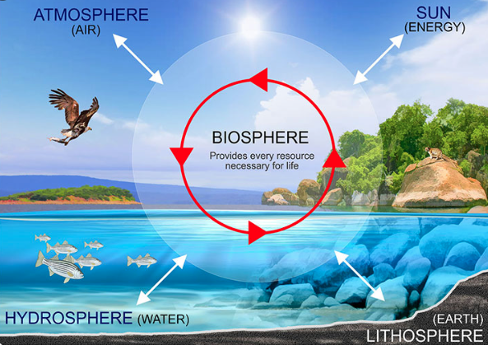
Checking for Understanding
What is the biosphere home to?
The Biosphere – home to all ecosystems
Vocabulary
The biosphere can be thought of as the intersection between the atmosphere (gases), the hydrosphere (water), the lithosphere (land) and all life on earth.
Ecosystem: A system formed by organisms interacting with each other and their non-living surroundings in a balanced way.
Biosphere: – all the plants and animals from the upper areas of atmosphere to deep underground or in the ocean.
The biosphere is the place were all life as we know it exists.
Notes:
CFU – read through the slide, have students look closely at the diagram, then allow think time, before asking them to explain it to their partner using the key terms pure substance and mixture. Call on non-volunteers and provide feedback, encouraging detailed responses in full sentence form.

Slide 17
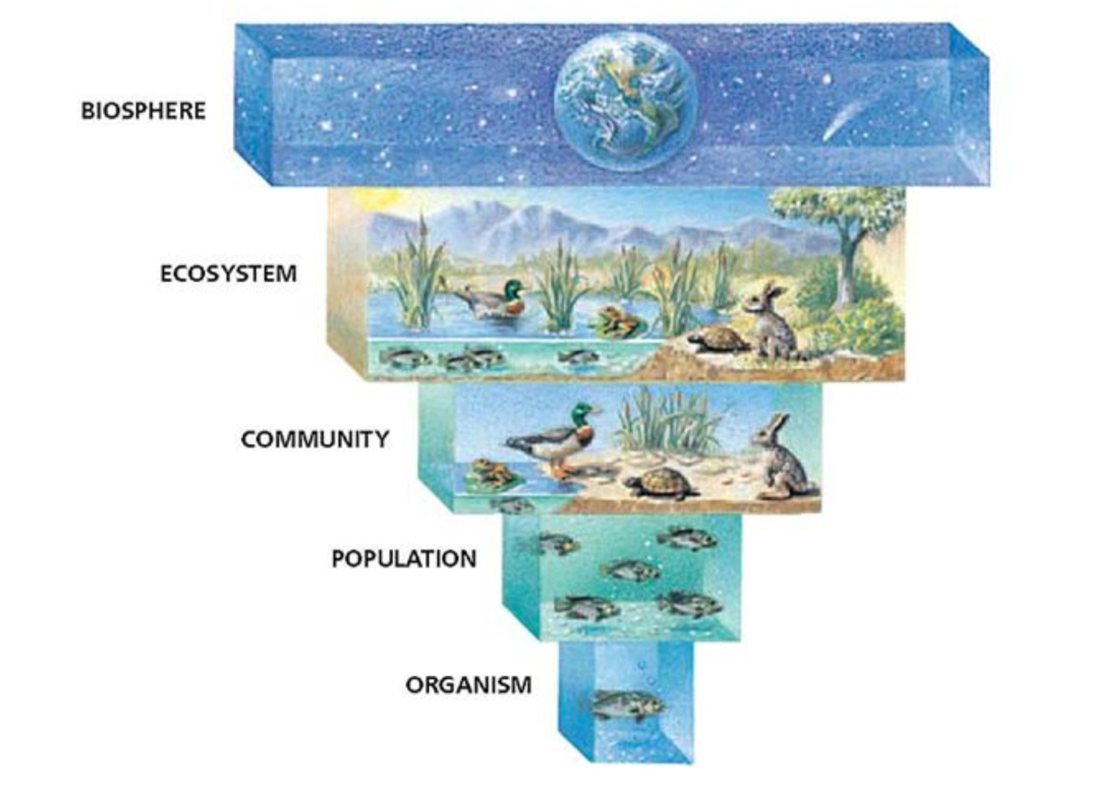
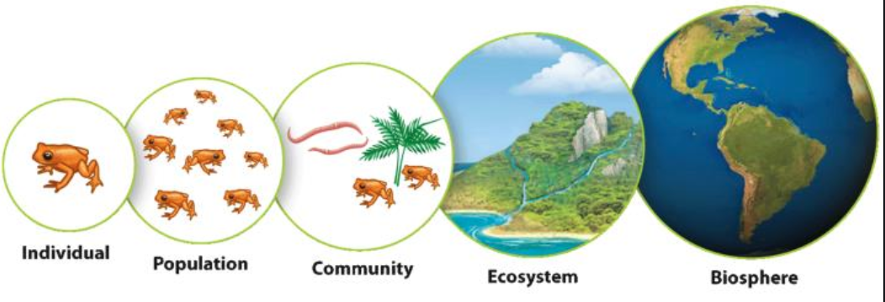
Checking for Understanding
Rank the following in order of largest to smallest.
Habitat, Biosphere & Ecosystem
The relationship between the biosphere, ecosystems and habitats.
Vocabulary
In the biosphere there are many ecosystems. In an ecosystem there are many habitats.
Ecosystem: A system formed by organisms interacting with each other and their non-living surroundings in a balanced way.
Biosphere: – all the plants and animals from the upper areas of atmosphere to deep underground or in the ocean.
Habitat: Environment in which organisms live.
Notes:
CFU – read through the slide, have students look closely at the diagram, then allow think time, before asking them to explain it to their partner using the key terms pure substance and mixture. Call on non-volunteers and provide feedback, encouraging detailed responses in full sentence form.

Slide 18
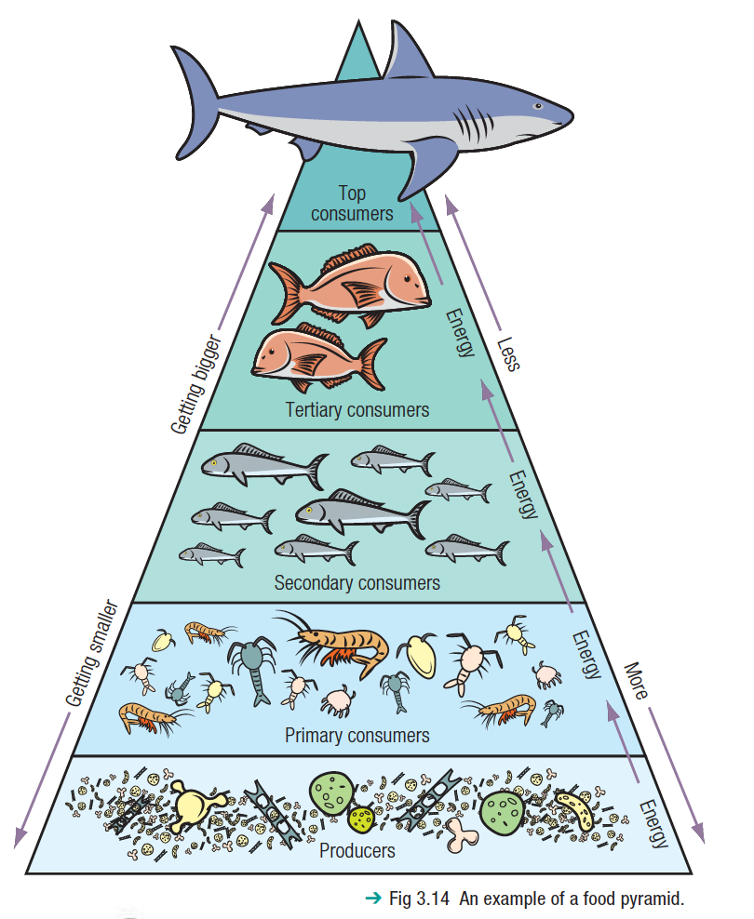
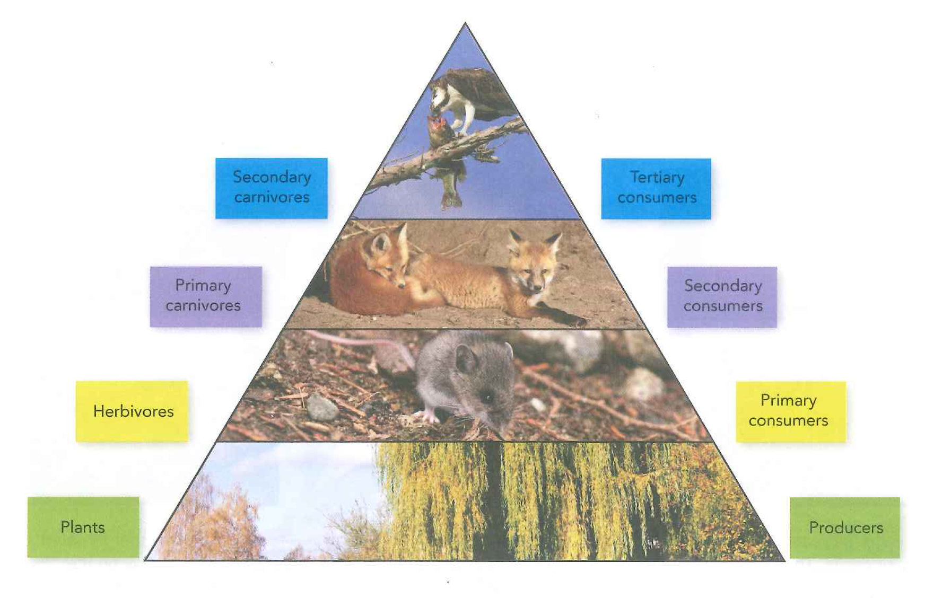
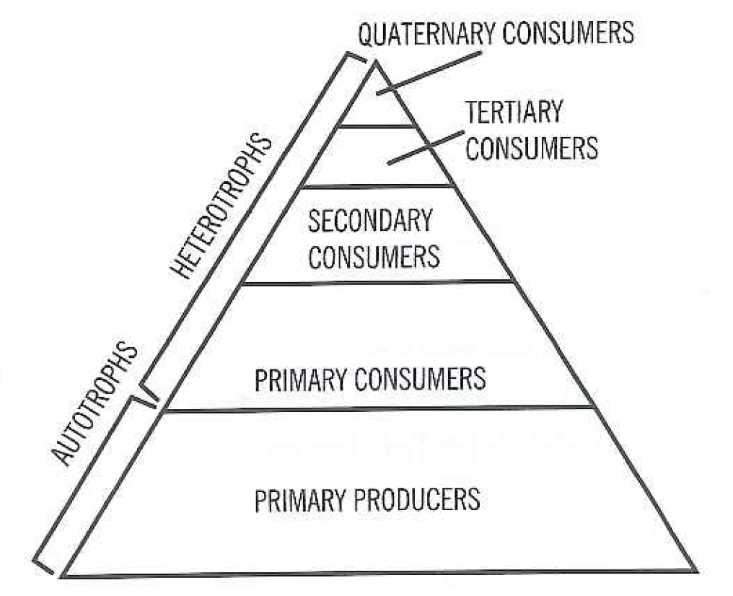
Hint
Trophic levels help demonstrate interactions in ecosystems
An energy pyramid is sometimes called a trophic pyramid or an ecological pyramid.
It is a graphical representation of the flow of energy at each trophic level.
The flow of energy moves through the layers of the energy pyramid from the bottom-up and is gradually reduced as energy is used up by the organisms at each level.
Vocabulary
Energy Pyramid: An energy pyramid is a graphical model of the energy flow in an ecosystem.
Trophic Levels: The trophic level of an organism is the position it occupies in a food web.

Slide 19
Checking for Understanding
What is the primary source of energy for all living things on earth?
What is the process in which plants get their energy?
Energy starts with the sun
The primary source of energy from all things living on earth is the sun.
Light energy from the sun reaches the earth’s surface and plants trap some of this energy using the chlorophyll (green pigment) in their leaves.
This is a process called photosynthesis, in which energy from the sun is used to convert carbon dioxide and water into oxygen and sugars.
Vocabulary
Photosynthesis: the process by which green plants and certain other organisms transform light energy into chemical energy.

Slide 20
Checking for Understanding
Organisms that produce their own food are known as?
An autotroph does what?
Producers
Organisms that produce their own food are known as producers or autotrophs. Plants can produce their own food, so they all called producers. Plants use the process of photosynthesis to make their own food.
Vocabulary
Photosynthesis: the process by which green plants and certain other organisms transform light energy into chemical energy.
Producers: Plants or plant-like organisms found at the start of the food chain.
Autotroph: Organism that makes its own food.
Not all producers are plants, phytoplankton (pictured above) are found the in the ocean.

Slide 21
Checking for Understanding
A consumer eats?
Consumers are also called?
Consumers
Animals cannot make their own food and must therefore consume (eat) plants or other animals to get their energy and the nutrients they need. Animals are therefore called consumers. Consumers are also called heterotrophs.
Consumers can be classified using different trophic levels (primary, secondary, tertiary consumers).
We help to classify their position using their food source (Carnivore, Omnivore and Herbivore).
Vocabulary
Consumer: Animals that cannot make their own food.
Heterotroph: Organism that does not make its own food.
Trophic Levels: The trophic level of an organism is the position it occupies in a food web.

Slide 22
Checking for Understanding
What does an Herbivore feed on?
What does a Carnivore feed on?
What does an Omnivore feed on?
Examples of Herbivores?
Examples of Carnivores?
Examples of Omnivores?
Consumers can be: Herbivores, Carnivores & Omnivores
Herbivore – an organism that feeds solely on plants.
Carnivore – an organism that feeds solely on animals.
Omnivore – an organism that consumes both plants and animals.
Consumers such as a grasshopper, kangaroos and koalas that eat only plants are known as herbivores.
Omnivores are consumers that eat plants and animals.
Humans and some bears are omnivores.
Consumers such as lions, dingoes and kookaburras that eat only other animals are called carnivores.
Vocabulary
Consumer: Animals that cannot make their own food. So they eat something to get their energy.

Slide 23
Checking for Understanding
What is a primary consumer?
What is a secondary consumer?
What is a tertiary consumer?
Classifying trophic level of consumers
Animals that eat only plants are referred to as herbivores, in an ecosystem they are referred to as primary consumers.
Animals that eat primary consumers are carnivores and called secondary consumers.
Omnivores can eat both can be a secondary consumer or a tertiary consumer.
Tertiary consumers are carnivores, that eat other carnivores.
Vocabulary
Primary Consumer: A consumer that eats a producer.
Secondary Consumer: A consumer that eats a primary consumer.
Tertiary Consumer: A consumer that eats a tertiary consumer.

Slide 24
Checking for Understanding
Quaternary Consumers
What is a quaternary consumer?
Some scientists include a group on the energy pyramid called Quaternary consumers. This group consists of larger carnivorous animals which eat smaller carnivores' animals. They are top predators in an ecosystem that usually have very few or no natural enemies.
Vocabulary
Quaternary Consumer: A consumer that sits at the top of the food chain?
Examples
Examples of quaternary consumers:

Slide 25
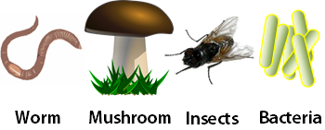
Checking for Understanding
Decomposers
What are decomposers?
If a plant or animal dies without being eaten, its body is broken down by decomposers. Decomposers are organisms such as bacteria and fungi that gets its energy they need as they break down dead matter and waste products.
Vocabulary
Decomposer: Organisms that get the energy they need by breaking down dead matter and waste products.

Slide 26
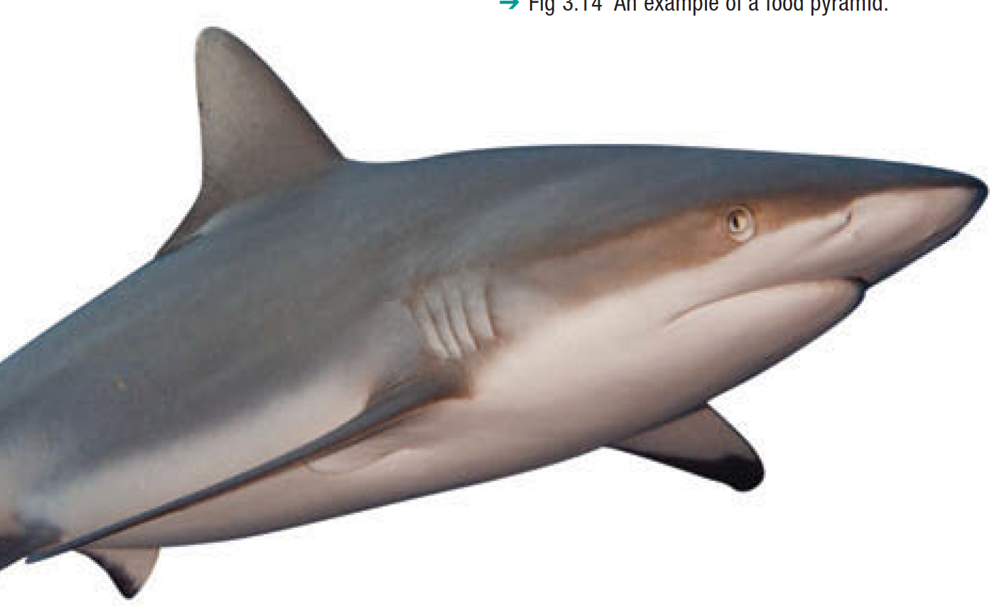
Predators & Prey
Animals that eat other animals are called predators
The animal that is eaten is called the prey.
For example, a dingo will hunt a hopping mouse.
The dingo is the predator, the mouse is the prey.
The shark will hunt a seal. The shark is the predator, the seal is the prey.
This is a good box to remind yourself to do something. Such as get them to write their answer on their whiteboard.
Notes:
Teacher Cue – read through the slide, thinking aloud/modelling each step with the picture provided as you go (A: this is a mixture)
CFU – ask students to tell their partner the 4 steps in their own words, trying to look at the list as few times as possible but using each other to jog each other’s memories
Have them record these steps in their notebooks if desired.

Slide 27
Skill Development
Identify the food source of the organism. (producer/consumer)
Identify the type of consumer (carnivore/omnivore/herbivore).
Identify if predator or prey may effect position.
Identifying trophic position
Classify the following organisms, which belong in a marine habitats, according to their trophic level. Use the words in the box.
Hints
Primary producer Quaternary Consumer
Tertiary consumer Secondary Consumer Primary consumer
Producer: Make their own food.
Consumers: Organisms that eat other organisms.
Primary Consumers: Herbivores
Secondary Consumer: Carnivores that eat primary consumers.
Tertiary Consumers: Carnivores that eat other carnivores.
Quaternary Consumers: Large carnivorous animals that eat smaller carnivorous animals.
Shark
Phytoplankton
Seals
Carnivore, Predator, eats large fish
Predator & Prey
Carnivore
Eats other carnivores
Autotroph
Quaternary Consumer
Producer
Secondary Consumer
Notes:
Teacher Cue – read through the slide, thinking aloud/modelling each step with the picture provided as you go (A: this is a mixture)
CFU – ask students to tell their partner the 4 steps in their own words, trying to look at the list as few times as possible but using each other to jog each other’s memories
Have them record these steps in their notebooks if desired.

Slide 28
Skill Development
Identify the food source of the organism. (producer/consumer)
Identify the type of consumer (carnivore/omnivore/herbivore).
Identify if predator or prey may effect position.
Identifying trophic position
Classify the following organisms, which belong in a marine habitats, according to their trophic level. Use the words in the box.
Hints
Primary producer Quaternary Consumer
Tertiary consumer Secondary Consumer Primary consumer
Producer: Make their own food.
Consumers: Organisms that eat other organisms.
Primary Consumers: Herbivores
Secondary Consumer: Carnivores that eat primary consumers.
Tertiary Consumers: Carnivores that eat other carnivores.
Quaternary Consumers: Large carnivorous animals that eat smaller carnivorous animals.
Herring
Zooplankton
Water flea
Known prey for larger fish, eats seaweed.
Autotroph
Eats producers
Primary Consumer/Secondary Consumer
Producer
Primary Consumer
Notes:
Teacher Cue – read through the slide, thinking aloud/modelling each step with the picture provided as you go (A: this is a mixture)
CFU – ask students to tell their partner the 4 steps in their own words, trying to look at the list as few times as possible but using each other to jog each other’s memories
Have them record these steps in their notebooks if desired.

Slide 29
Skill Development
Identify the food source of the organism. (producer/consumer)
Identify the type of consumer (carnivore/omnivore/herbivore).
Identify if predator or prey may effect position.
Identifying trophic position
Classify the following organisms, which belong in a marine habitats, according to their trophic level. Use the words in the box.
Hints
Primary producer Quaternary Consumer
Tertiary consumer Secondary Consumer Primary consumer
Producer: Make their own food.
Consumers: Organisms that eat other organisms.
Primary Consumers: Herbivores
Secondary Consumer: Carnivores that eat primary consumers.
Tertiary Consumers: Carnivores that eat other carnivores.
Quaternary Consumers: Large carnivorous animals that eat smaller carnivorous animals.
Whale
Kingfisher
Algae
Consumer, eats both zooplankton, phytoplankton and small fish
Can be prey for sharks.
Consumer eats small fish.
Can be prey for larger birds.
Gains energy from sunlight
Notes:
Teacher Cue – read through the slide, thinking aloud/modelling each step with the picture provided as you go (A: this is a mixture)
CFU – ask students to tell their partner the 4 steps in their own words, trying to look at the list as few times as possible but using each other to jog each other’s memories
Have them record these steps in their notebooks if desired.

Slide 30
Checking for Understanding
Why do we need to learn about Ecosystems.
Ecology is the study of…?
The study of the interactions between living things and their environment is called ecology.
Ecologists are scientists who study these interactions.
The study of ecology is important in ensuring people understand the impact of their actions on the life of the planet as well as on each other. Here are some of the reasons why ecology is important:
Fighting climate change.
Environmental conservation.
Species conservation.
Educating the general public about environmental sustainability.
Vocabulary
Ecologist: The study of the interactions between living things and their environment.
Notes:
CFU – pair-share, call on volunteers.

Slide 31
Questioning
A hinge-point question is based on a concept in a lesson that is important for students to understand before the teacher moves on in the lesson.
The lesson can go one of two ways depending on student understanding, which is made clear from the students’ answers to the hinge-point question.
A hinge-point question can be asked at any point in a lesson.
A good hinge-point question meets the following criteria:
it doesn’t take too long to ask (e.g. around 30 seconds)
it doesn’t take too long for students to respond (e.g. around a minute)
all students in the class respond at the same time
it doesn’t take too long for the teacher to scan and interpret the responses (no more than 30 seconds)
Students who get the answer right get it right for the right reason.

Slide 32

Students will be able to:
Understand the interrelationship between the biosphere, ecosystems, environment's and habitats.
Understand and identify the different trophic levels that exist in the food pyramid.
State the role of an ecologist.

Slide 33
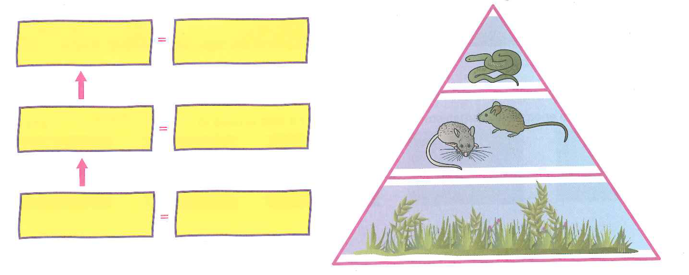
Your turn:
Write the names of the organism shown in the food pyramid in the first column of boxes. Classify each of these organisms as producer, herbivore or carnivore and write this in the boxes next to the names of the organisms.

Slide 34
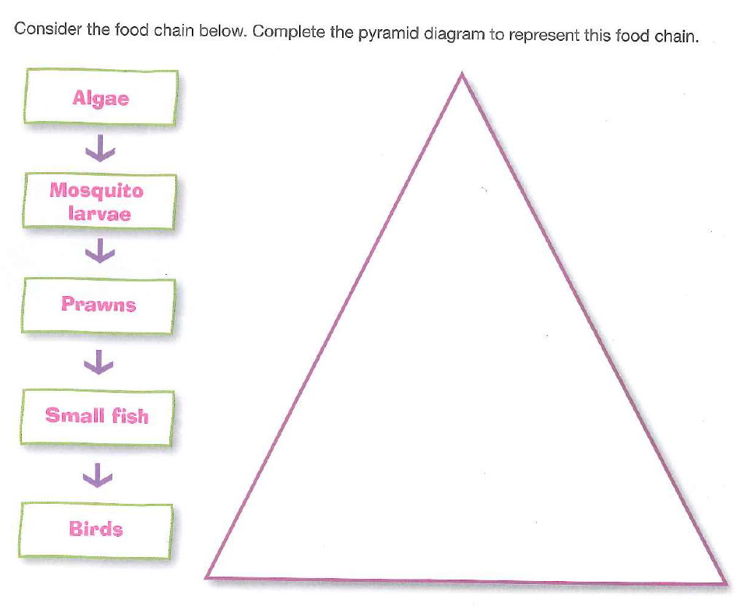

Create a food pyramid using the following organisms. Label the trophic levels

Slide 35
Your turn:
Questions:
What is the difference between a primary source of energy, a primary producer and a primary consumer?
What is the relationship between secondary, tertiary and quaternary consumers in a food chain. Give an example of each.
Explain the difference between an autotroph and a heterotroph.

Slide 36
New Word
tim id ly
‘tim(ere)’
‘id’
‘ly’
fear
descendant of
modify to describe
Adverb: acting in a way that shows fear or lacking confidence.

